Slide 1
Microprocessors, Microcontrollers & Embedded systems
8051 architecture

Slide 2
Contents
8051 architecture
Oscillator & Clock
Programming model
Special function registers

Slide 3
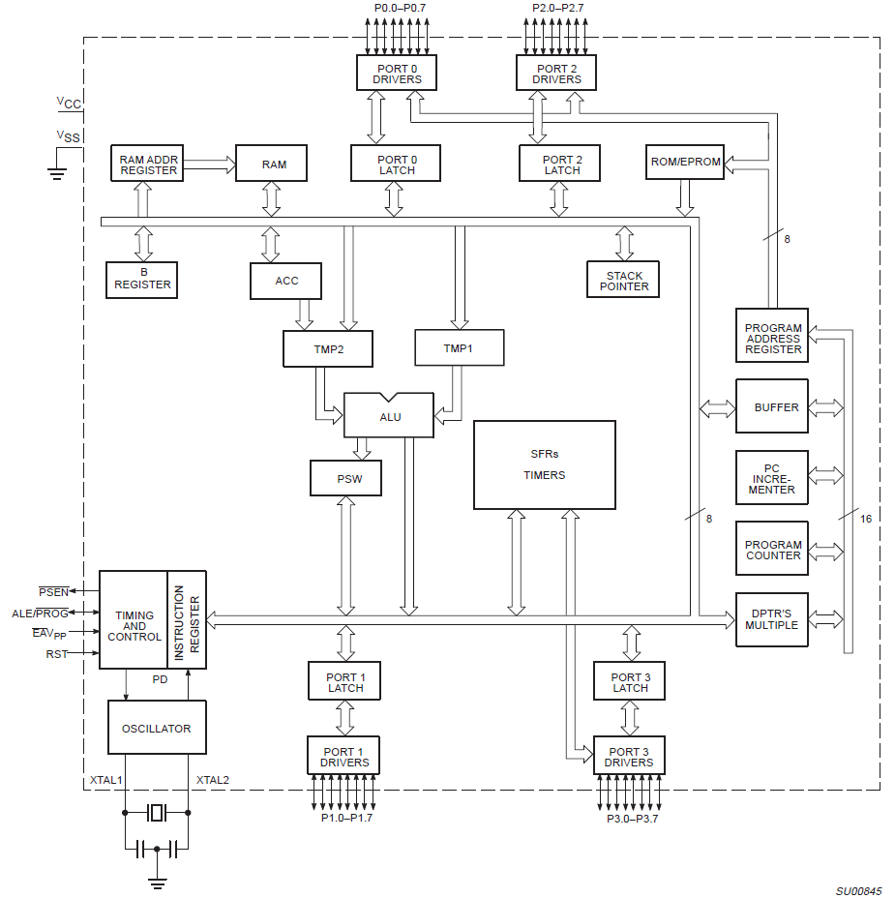
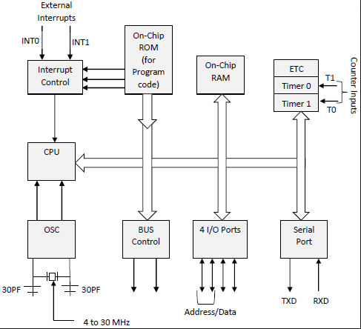
8051 architecture
From the datasheet

Slide 4
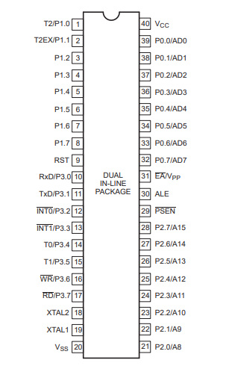
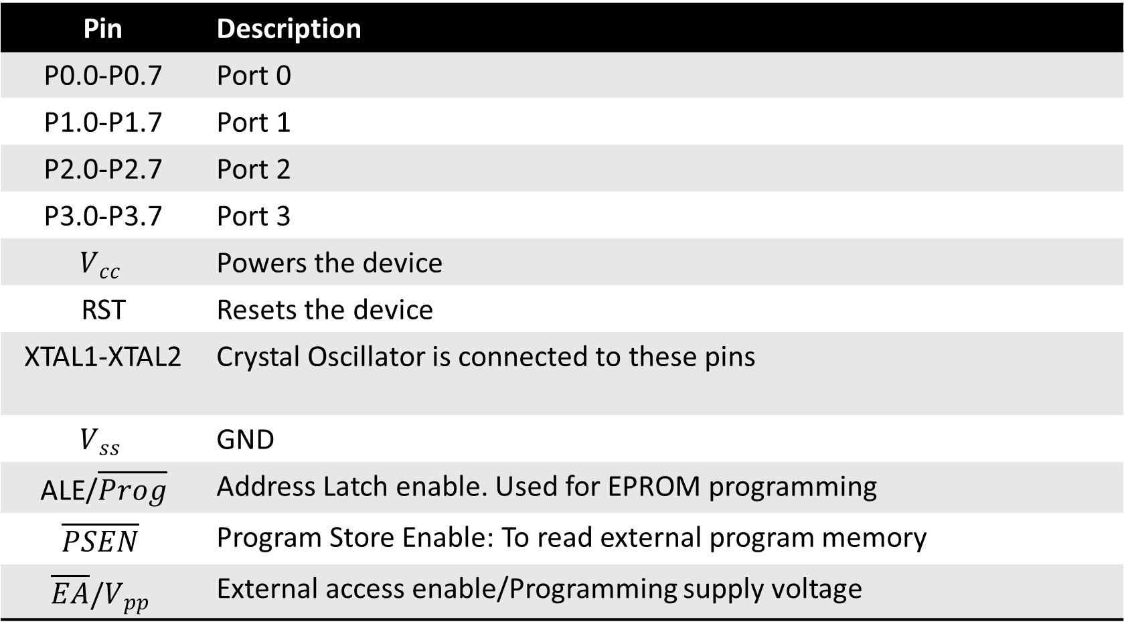
8051 pin configuration
Pin | Description
P0.0-P0.7 | Port 0
P1.0-P1.7 | Port 1
P2.0-P2.7 | Port 2
P3.0-P3.7 | Port 3
$$V_{cc}$$ | Powers the device
RST | Resets the device
XTAL1-XTAL2 | Crystal Oscillator is connected to these pins
$$V_{ss}$$ | GND
ALE/$\overline{Prog}$ | Address Latch enable. Used for EPROM programming
$$\overline{PSEN}$$ | Program Store Enable: To read external program memory
$$\overline{EA}/V_{pp}$$ | External access enable/Programming supply voltage
Notes:
RD bar is to read external data memory while PSEN bar is to read external program memory.
When the device is executing code from the external program memory, PSEN is activated twice each machine cycle, except that two PSEN activations are skipped during each access to external data memory. PSEN is not activated during fetches from internal program memory.

Slide 5
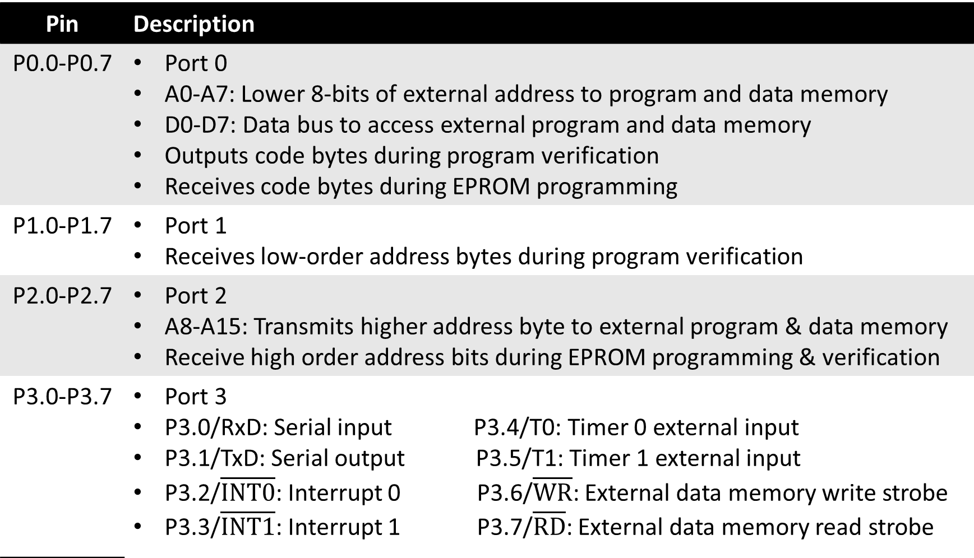
8051 pin configuration
Pin | Description
P0.0-P0.7 | Port 0 A0-A7: Lower 8-bits of external address to program and data memory D0-D7: Data bus to access external program and data memory Outputs code bytes during program verification Receives code bytes during EPROM programming
P1.0-P1.7 | Port 1 Receives low-order address bytes during program verification
P2.0-P2.7 | Port 2 A8-A15: Transmits higher address byte to external program & data memory Receive high order address bits during EPROM programming & verification
P3.0-P3.7 | Port 3 P3.0/RxD: Serial input P3.4/T0: Timer 0 external input P3.1/TxD: Serial output P3.5/T1: Timer 1 external input P3.2/$\overline{INT0}$: Interrupt 0 P3.6/$\overline{WR}$: External data memory write strobe P3.3/$\overline{INT1}$: Interrupt 1 P3.7/$\overline{RD}$: External data memory read strobe

Slide 6
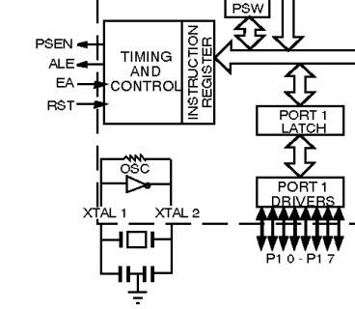
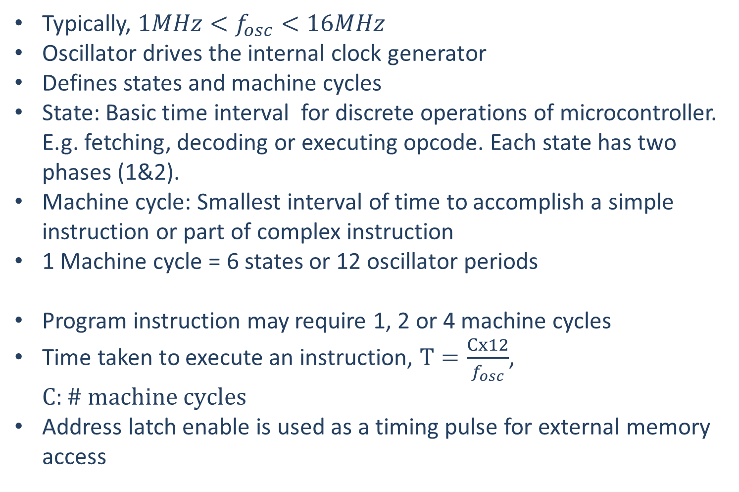
8051 Oscillator & Clock
Typically, $1MHz<f_{osc}<16MHz$
Oscillator drives the internal clock generator
Defines states and machine cycles
State: Basic time interval for discrete operations of microcontroller. E.g. fetching, decoding or executing opcode. Each state has two phases (1&2).
Machine cycle: Smallest interval of time to accomplish a simple instruction or part of complex instruction
1 Machine cycle = 6 states or 12 oscillator periods
Program instruction may require 1, 2 or 4 machine cycles
Time taken to execute an instruction, $T=\frac{Cx12}{f_{osc}}$, $C:\# machine cycles$
Address latch enable is used as a timing pulse for external memory access
Notes:
Typically, arithmetic and logical operations take place during Phase 1 and internal register-to-register transfers take place during Phase 2.

Slide 7
8051 Special function registers
Accumulator
B Register
PC
PSW
SP
Data pointer
Ports 0 to 3: P0, P1, P2, P3
Serial data buffer SBUF
Timer Registers: (TH0, TL0) & (TH1, TL1)
Control registers: IP, IE, TMOD, TCON, SCON & PCON: Contain the control and status bits for interrupts, timers/counters & serial port
Refer to 8051 datasheet: Page 8
https://www.nxp.com/docs/en/data-sheet/8XC51_8XC52.pdf
Each of these registers have an 8-bit address except the PC
Why is the address necessary?
Notes:
Typically, arithmetic and logical operations take place during Phase 1 and internal register-to-register transfers take place during Phase 2.

Slide 8
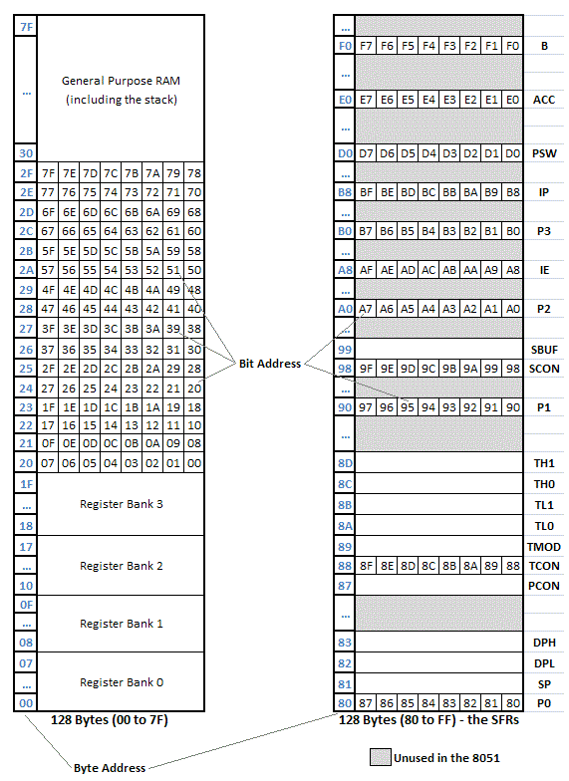
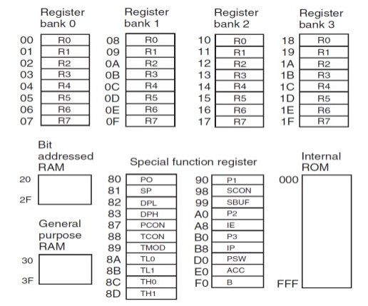
8051 Programming model
Internal ROM address: 0x000-0xFFF
Internal RAM address: 0x00-0x7F
Four register banks: 0x00-0x1F
Bit addressed RAM: 0x20-0x2F
General purpose RAM: 0x30-0x7F
Special function Registers
Specific addresses between 0x80-0xF0
External memory access:
If EA = 0, external address: 0x1000-0xFFFF
If EA = 1, external address: 0x0000-0xFFFF
7F
8051 programming model
Notes:
EA = 0 implies EA bar = 1

Slide 9
THANKS
Notes:
EA = 0 implies EA bar = 1

